Slide 1

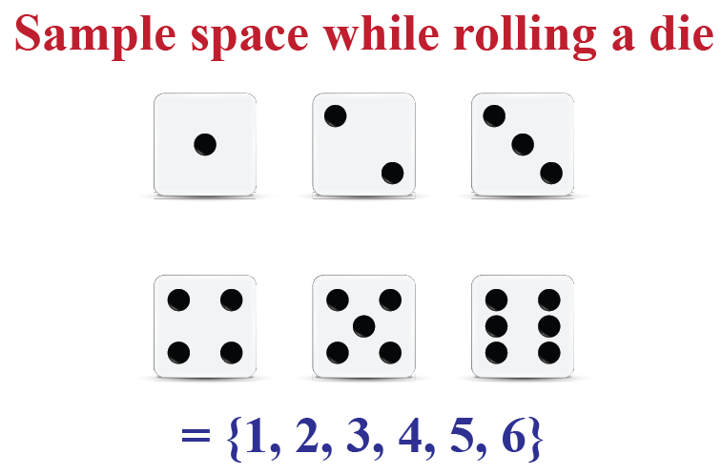

Independent Events
If P(A) ≠ 0 and P(B) ≠ 0
then mutual exclusivity
implies dependence,
because
P(A∩B) = 0 ≠ P(A)*P(B)
Mutually Exclusive Events
Knowing that A happens doesn’t change probability that B happened
P(A|B) = P(A) (given that P(B) ≠ 0)
A and B cannot occur together
P(A∩B) = 0
A and B have no intersection
The occurrence of event A doesn’t affect the occurrence of event B
P(A∩B) = P(A)*P(B)
 | A |  |  |  | B
E.g. – rolling two dies:
Event A: rolling 6 with first die
Event B: rolling 1 with second die
Dependent Events
P(A∩B) = P(B) * P(A|B)
E.g. – rolling two dies:
Event A: rolling 6 with first die
Event B: rolling 11+ total with both dies
Event A -> P(A) = 1/6
Event B -> P(B) = 3/36
E.g. – rolling one die:
Event A: rolling 6
Event B: rolling 1
Universe #1
Universe #2
Universe #3
Event A∩B -> P(A∩B) = 2/36
Universe #1
Universe #2
Universe #1
P(A) = 1/6
P(B) = 1/6
P(A∩B) = 1/36 = P(A) * P(B)
Universe #2
P(A∩B) = 2/36 ≠ P(A) * P(B) = 3/216
P(A∩B) = P(B) * P(A|B) = 1/6 * 2/6 = 2/36

